Slide 1
HNDIT 2312-Principles of Software Engineering
Week 10: Software Testing

Slide 2
Topics Covered
Development Testing
Goals of testing
Software testing methods
Software testing vs. inspection
Stages of testing
Quality assurance
Test Automation

Slide 3
Program testing
Testing is intended to show that a program does what it is intended to do and to discover program defects before it is put into use.
You check the results of the test run for errors, anomalies or information about the program’s non-functional attributes.

Slide 4
Testing process goals
Validation testing
To demonstrate to the developer and the system customer that the software meets its requirements
Defect testing
To discover faults or defects in the software where its behavior is incorrect or not in conformance with its specification

Slide 5
Verification vs. validation
Verification:
"Are we building the product right”.
The software should conform to its specification.
Validation:
"Are we building the right product”.
The software should do what the user really requires.

Slide 6
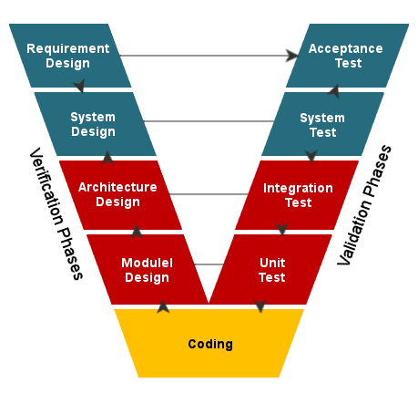
V Model

Slide 7
Inspections and testing
Software inspections(Static Verification)
Concerned with analysis of the static system representation to discover problems.
Code analysis
Software testing (Dynamic Verification)
The system is executed with test data and its operational behavior is observed.

Slide 8
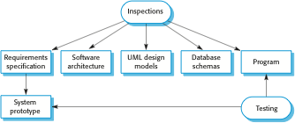
Inspections and testing

Slide 9

A model of the software testing process

Slide 10
Software Testing - Methods
Black box testing
The technique of testing without having any knowledge of the interior workings of the application is called black-box testing.
White box testing
White-box testing is the detailed investigation of internal logic and structure of the code.
Grey box testing

Slide 11
Black box tests-techniques
Equivalence Partitioning
Boundary Value Analysis

Slide 12
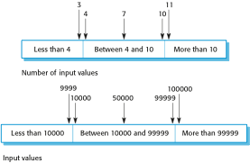
Equivalence partitioning

Slide 13
White box tests-techniques
Procedure to derive and/or select test cases.
Test cases involve the set of steps, conditions and inputs which can be used while performing the testing tasks.

Slide 14
Stages of testing
Development testing
where the system is tested during development to discover bugs and defects.
Release testing
where a separate testing team test a complete version of the system before it is released to users.
User testing
where users or potential users of a system test the system in their own environment.

Slide 15
Development testing
Unit testing
where individual program units or object classes are tested.
Component testing
where several individual units are integrated to create composite components.
System testing
where some or all of the components in a system are integrated and the system is tested as a whole.

Slide 16
Unit testing
Units may be
Individual functions or methods within an object
Object classes with several attributes and methods
Composite components with defined interfaces used to access their functionality.

Slide 17
Component testing
Software components are often composite components that are made up of several interacting objects.
You access the functionality of these objects through the defined component interface.

Slide 18
System testing
System testing during development involves integrating components to create a version of the system and then testing the integrated system.
System testing tests the emergent behaviour of a system.

Slide 19
Release testing
The primary goal of the release testing process is to convince the supplier of the system that it is good enough for use.
Release testing is usually a black-box testing process where tests are only derived from the system specification.
Ex-performance tetsting

Slide 20
Performance testing
Part of release testing may involve testing the emergent properties of a system, such as performance and reliability.
Stress testing is a form of performance testing where the system is deliberately overloaded to test its failure behavior.

Slide 21
User testing
User or customer testing is a stage in the testing process in which users or customers provide input and advice on system testing.

Slide 22
Types of user testing
Alpha testing
Users of the software work with the development team to test the software at the developer’s site.
Beta testing
A release of the software is made available to users to allow them to experiment and to raise problems that they discover with the system developers.
Acceptance testing
Customers test a system to decide whether or not it is ready to be accepted from the system developers and deployed in the customer environment.

Slide 23
Testing and Debugging
Testing
It involves identifying bug/error/defect in a software without correcting it.
Debugging
It involves identifying, isolating, and fixing the problems/bugs.

Slide 24
Quality Assurance
QA includes activities that ensure the implementation of processes, procedures and standards in context to verification of developed software and intended requirements.
Process-oriented activities

Slide 25
Automation Testing
Automation testing, which is also known as Test Automation, is when the tester writes scripts and uses another software to test the product.

Slide 26
Software Testing Tools
HP Quick Test Professional
Selenium
IBM Rational Functional Tester
SilkTest
TestComplete
Testing Anywhere
WinRunner
LoadRunner
Visual Studio Test Professional
WATIR

Slide 27
Key points
Testing can only show the presence of errors in a program. It cannot demonstrate that there are no remaining faults.
Development testing is the responsibility of the software development team. A separate team should be responsible for testing a system before it is released to customers.

